Slide 1

Sagemaker Canvas Introduction
AWS Sagemaker Canvas Tutorial

Slide 2
Amazon SageMaker Canvas is a new visual, no code capability that allows business analysts to build ML models and generate accurate predictions without writing code or requiring ML expertise.
AWS Sagemaker Canvas Tutorial

Slide 3
Its intuitive user interface lets you browse and access disparate data sources in the cloud or on-premises, combine datasets with the click of a button, train accurate models, and then generate new predictions once new data is available.
AWS Sagemaker Canvas Tutorial

Slide 4
For the Organizations facing business problems and dealing with data on a daily basis, the ability to build systems that can predict business outcomes becomes very important. With a No Code tool, all teams and individual decision makers in the organization are empowered to create these machine learning (ML) systems at scale, without depending on other data science and data engineering teams, also without the need to learn about hundreds of algorithms, training parameters, evaluation metrics, and deployment best practices.
AWS Sagemaker Canvas Tutorial

Slide 5
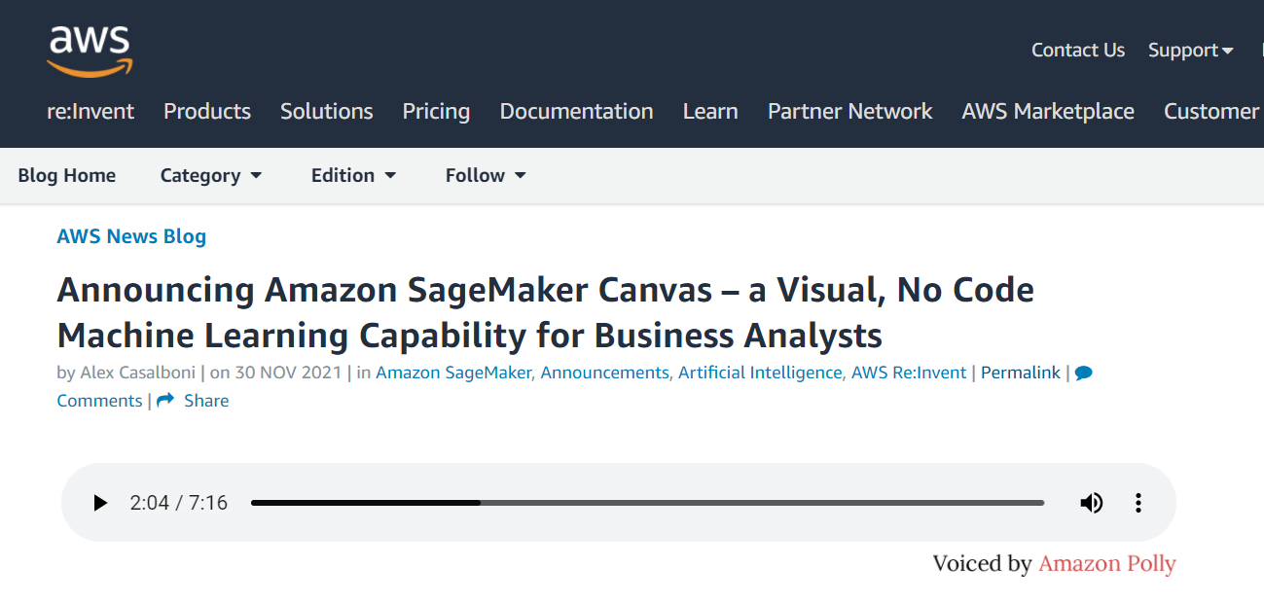
AWS Sagemaker Canvas Tutorial

Slide 6
Canvas automatically clean and combine your data. It then creates hundreds of models under the hood & select the best performing one. Finally, it generates new individual or batch predictions It supports multiple problem types such as binary classification, multi-class classification, numerical regression, and time series forecasting.
AWS Sagemaker Canvas Tutorial

Slide 7
Canvas can easily address multiple business-critical use cases, such as fraud detection, churn reduction, and inventory optimization, without writing a single line of code !
AWS Sagemaker Canvas Tutorial

Slide 8
1. Divide the Dataset into Train and Test 2. Add the dataset to SageMaker Canvas 3. Only take into consideration the correct columns for prediction 4. Build the Model using Quick Build 5. Check how accuracy changes when a column is removed or added 6. Create Versions 7. Finally Predict the values using Test Dataset and compare with the actual values 8. Try Standard Build and share with SageMaker Studio
AWS Sagemaker Canvas Practice Assignment

